Slide 1
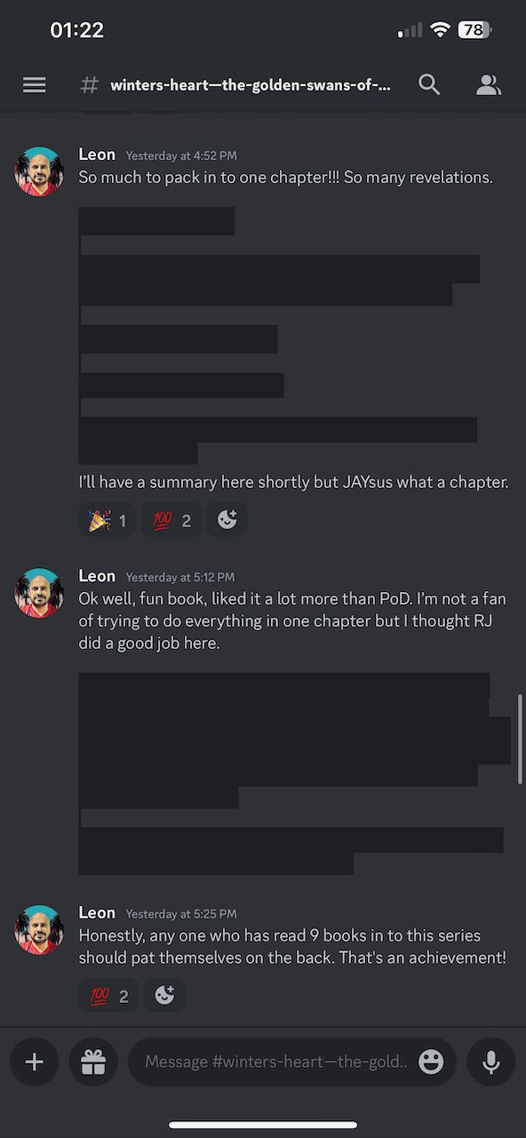
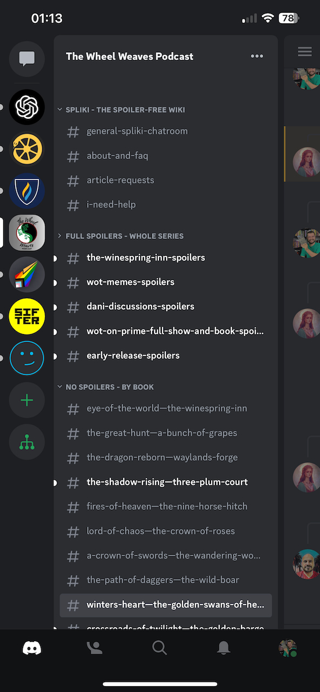









Community Title
Topic Tab
Text channel
Channel 1
Topic Tab
Channel 1
Topic Tab
Channel 1

